Slide 1
ACWW Update for RWNZ
by Claire Mahon
ACWW Board Member & RWNZ Member

Slide 2
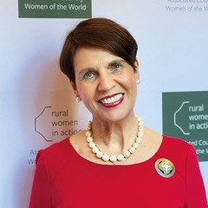
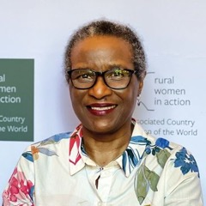
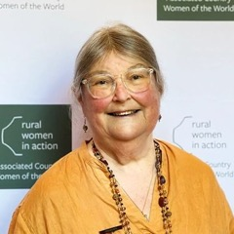
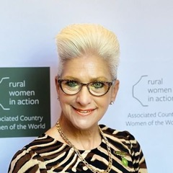
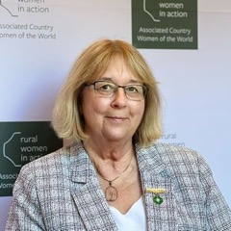
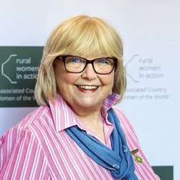
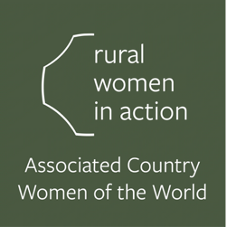
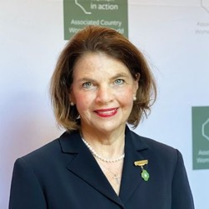
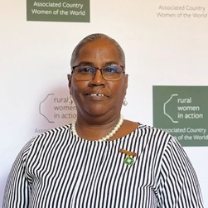
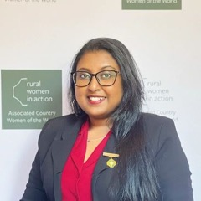
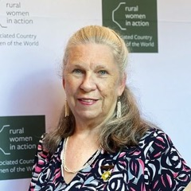
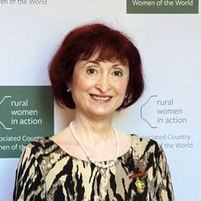
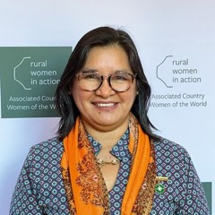
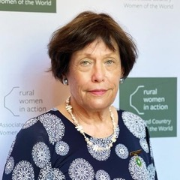
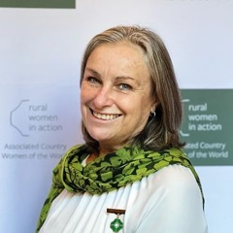
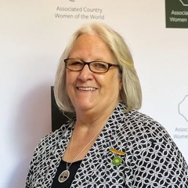
ACWW
Board of Trustees
2023-2026

Slide 3
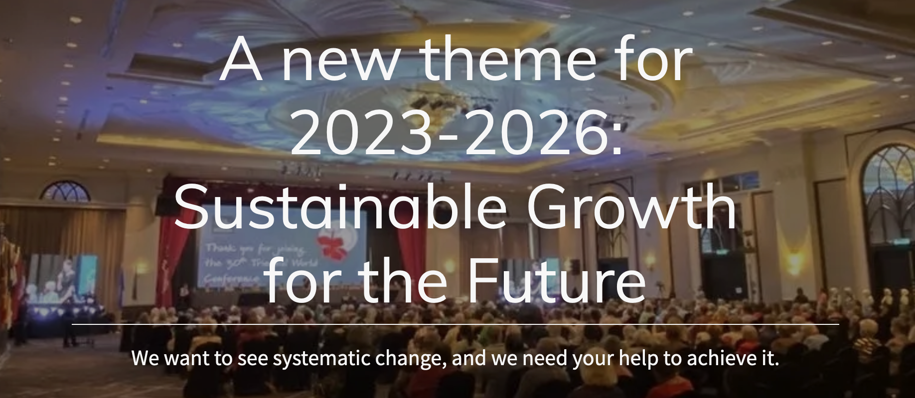

Slide 4
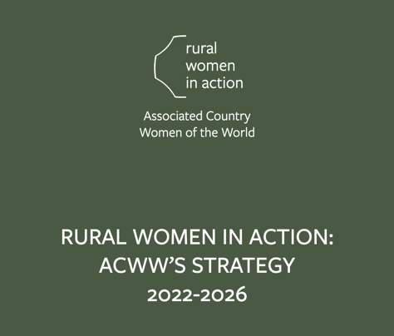
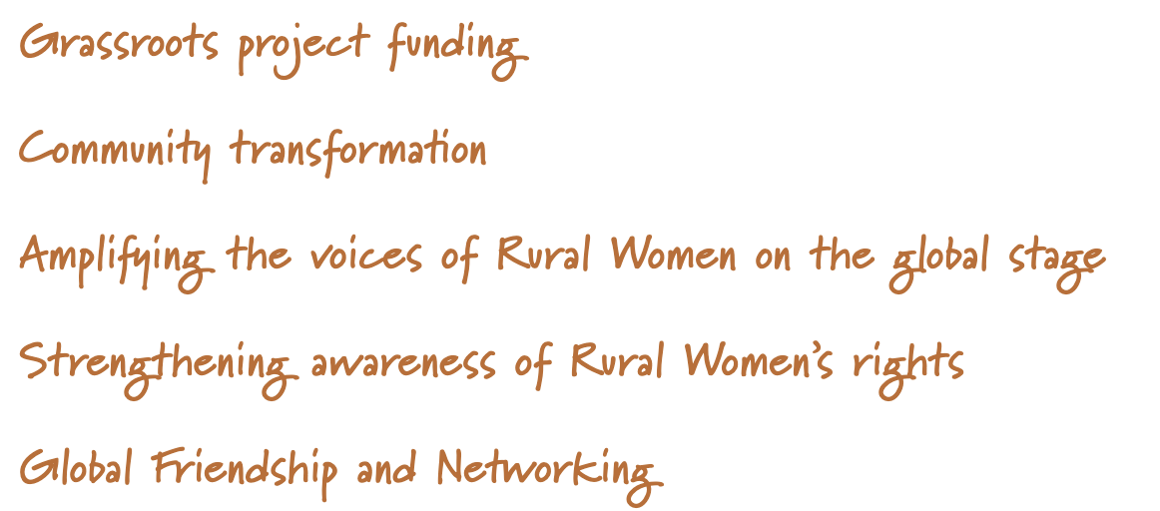
Some things change, but the focus remains the same

Slide 5
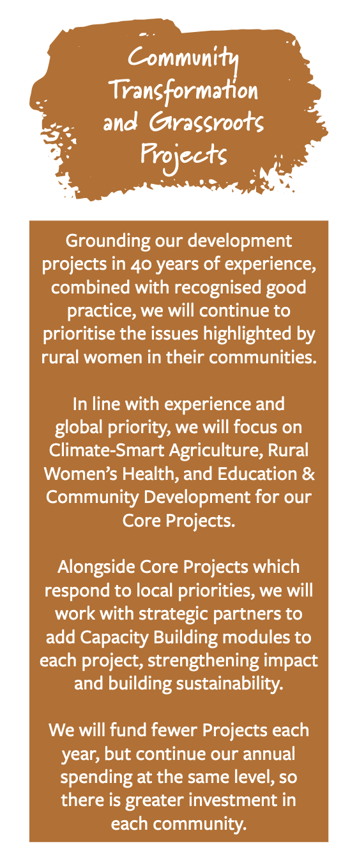
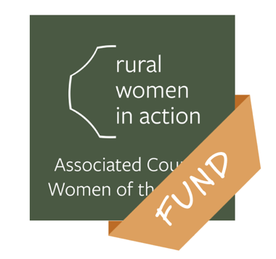
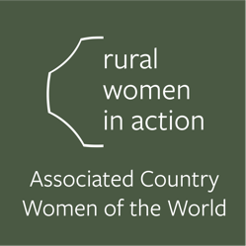
In July 2022 the Rural Women in Action Fund replaced Pennies for Friendship and is the all-purpose fund for ACWW work and activities
Notes:
Keeping in line with changing regulatory requirements in the UK (and similar to the changes in New Zealand and around the world), bank accounts need to be consolidated and held only by Head Office, etc

Slide 6
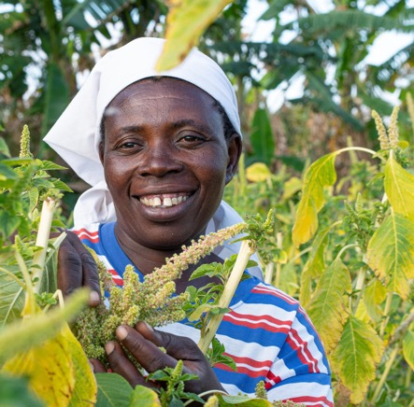
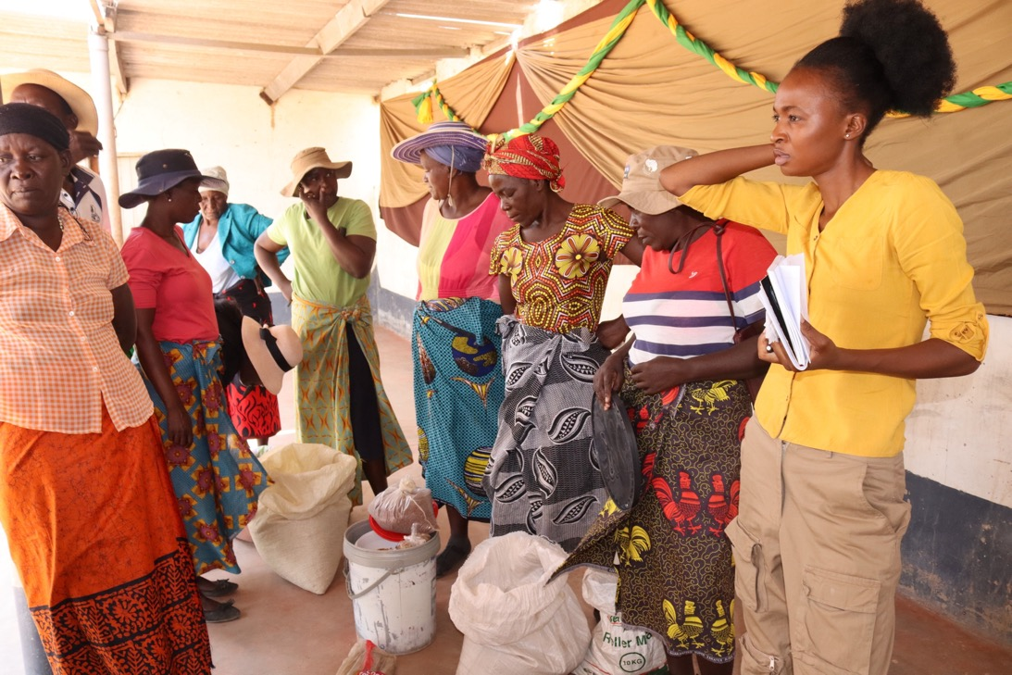
Notes:
Community Transformation and Grassroots Projects
Our new strategy sees the launch of a new programme of development projects, ensuring greater community impact for the women most at risk of being left behind.
Grounding our development projects in 40 years of experience, combined with recognised good practice, we will continue to prioritise the issues highlighted by rural women in their communities. In line with experience and global priority, we will focus on Climate-Smart Agriculture, Rural Women’s Health, and Education & Community Development for our Core Projects.
Alongside Core Projects which respond to local priorities, we will work with strategic partners to add Capacity Building modules to each project, strengthening impact and building sustainability. We will fund fewer Projects each year, but continue our annual spending at the same level, so there is greater investment in each community.
ACWW’s work can be divided into three areas of focus: Climate-smart Agriculture, Rural Women’s Health, and Education and Community Development. We fund development projects in these areas, which not only improves rural communities all over the world, but also contributes to effective and informed lobbying and advocacy. These focus areas reflect the priority needs of rural communities globally, ACWW’s expertise, and align with our constitutional aims and objectives.

Slide 7
Through external funding we can host
Women’s Empowerment Summits
Linking grantees with new funders
Grant writing
Notes:
This diagram is a map of what an example Rural Women in Action Fund project looks like.
The opportunities for community and individual development are significant, and ACWW is using its network and years of experience to bring about real, measurable change. In addition to the capacity building modules, ACWW has the opportunity to work with strategic partners to develop digital and financial infrastructure in communities that need it, responding to the unique needs of each community. Additionally, this means that we will be able to make greater impact in our three areas of focus, and that the impact will be more effectively and efficiently measured.
We are making investments into the monitoring and evaluation of our projects. This will allow us to not only better measure our impact, but it will also allow us to learn from our experiences first hand, and also produce media that brings our supporters even closer to the initiatives they are supporting. We will be able to hear stories straight from our partners and project participants, amplifying their voices and experiences to the ACWW network and support our advocacy work at the UN.

Slide 8
Notes:
In August this year, ACWW and longtime project partner Sain Tus Development Bridge ran a 3-day empowerment summit in Khovd, western Mongolia.
The summit brought together over 300 nomadic herds women to participate in sessions on economic empowerment and financial literacy, community safeguarding, and rabies education. The event centered on supporting survivors of domestic violence to access services and support and to assess community needs for the future.

Slide 9
Notes:
The event built on a recent project facilitated by Sain Tus Development Bridge and funded by ACWW which addressed violence against women through economic opportunities in vegetable production and access to support services. This project which was funded in 2022 reached 100 women in Khovd.
Funding secured from the UNESCO Participation Programme allowed ACWW to develop the empowerment summit event with Sain Tus to increased the reach of the recent project, expanding the project out to a further 300 women from more remote areas to be able to travel into the city.

Slide 12
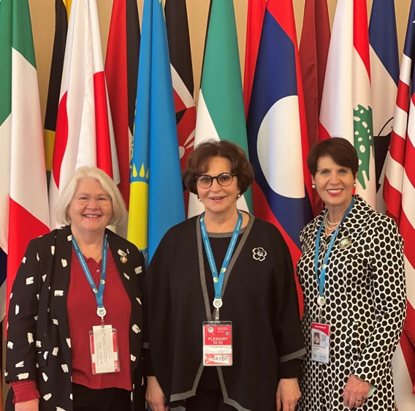
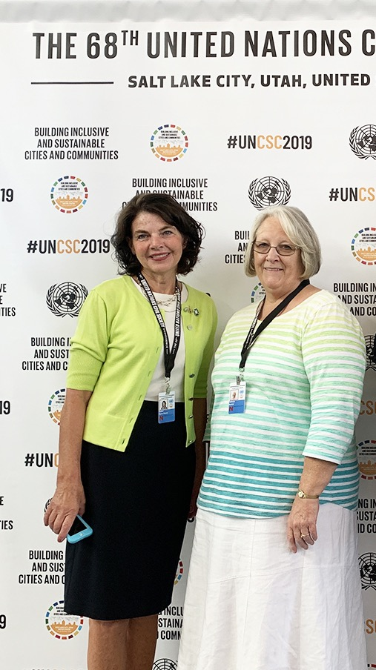
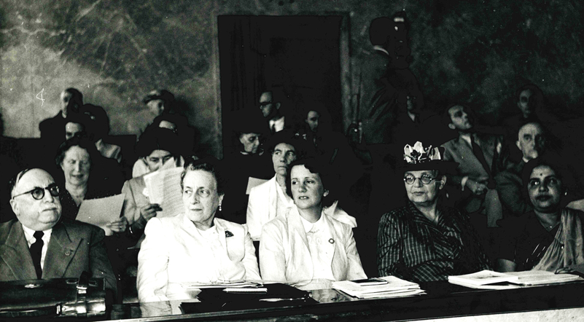
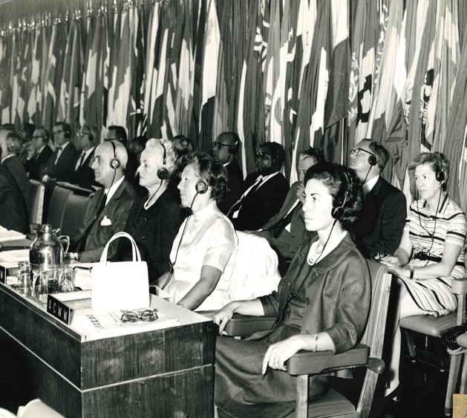
Notes:
It is important to understand that our projects, and the processes we use to amplify the voices of our members are completely and vitally linked. This means that the impacts of our projects are only sustainable when they exist in an enabling environment, with progressive legislation within local and national governing bodies.
ACWW approaches this process from two directions.
Empowering women to take their place in decision-making in their communities This can be achieved by promoting awareness of the rights of women, providing access to a network of supportive women, and sharing knowledge.
2. Engaging with UN processes that hold governments to account when they fail rural women This can be achieved through our consultative status with the UN Economic and Social Council, where we have access to key deliberative opportunities. We use our network and contacts through multiple governments, organisations, and mechanisms at the UN to lobby for the rights of rural women globally.
Systemic change means ‘changes to systems.’ The systems we are referring to here are those that keep women from attaining full equality in all things. It is only by tackling these issues from both directions that we can bring about true sustainability.
These photos are from the UN CSC 2019 with former UN Committee Chair Marie Kenny, who is now the current Area President for Canada, and Bonnie Teeples Area President for the USA. The top photo is from the Third Eurasian Women’s Forum in St Petersburg Russia in 2021, where World President Magdie de Kock, Executive Director Tish Collins, and Advocacy Director Nick Newland (not pictured) represented ACWW.
The B&W photo is of ACWW reps sitting among other women’s groups and organisations at the FAO 51st Session Council in 1968.
The final photo is of ACWW Representatives at an NGO Conference in Geneva in 1950

Slide 13
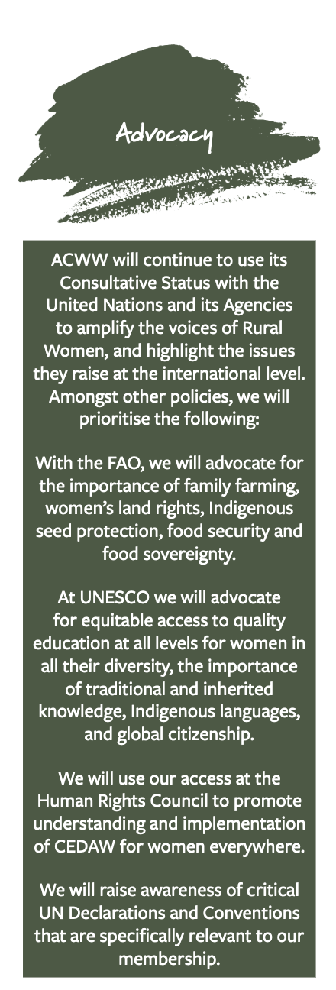
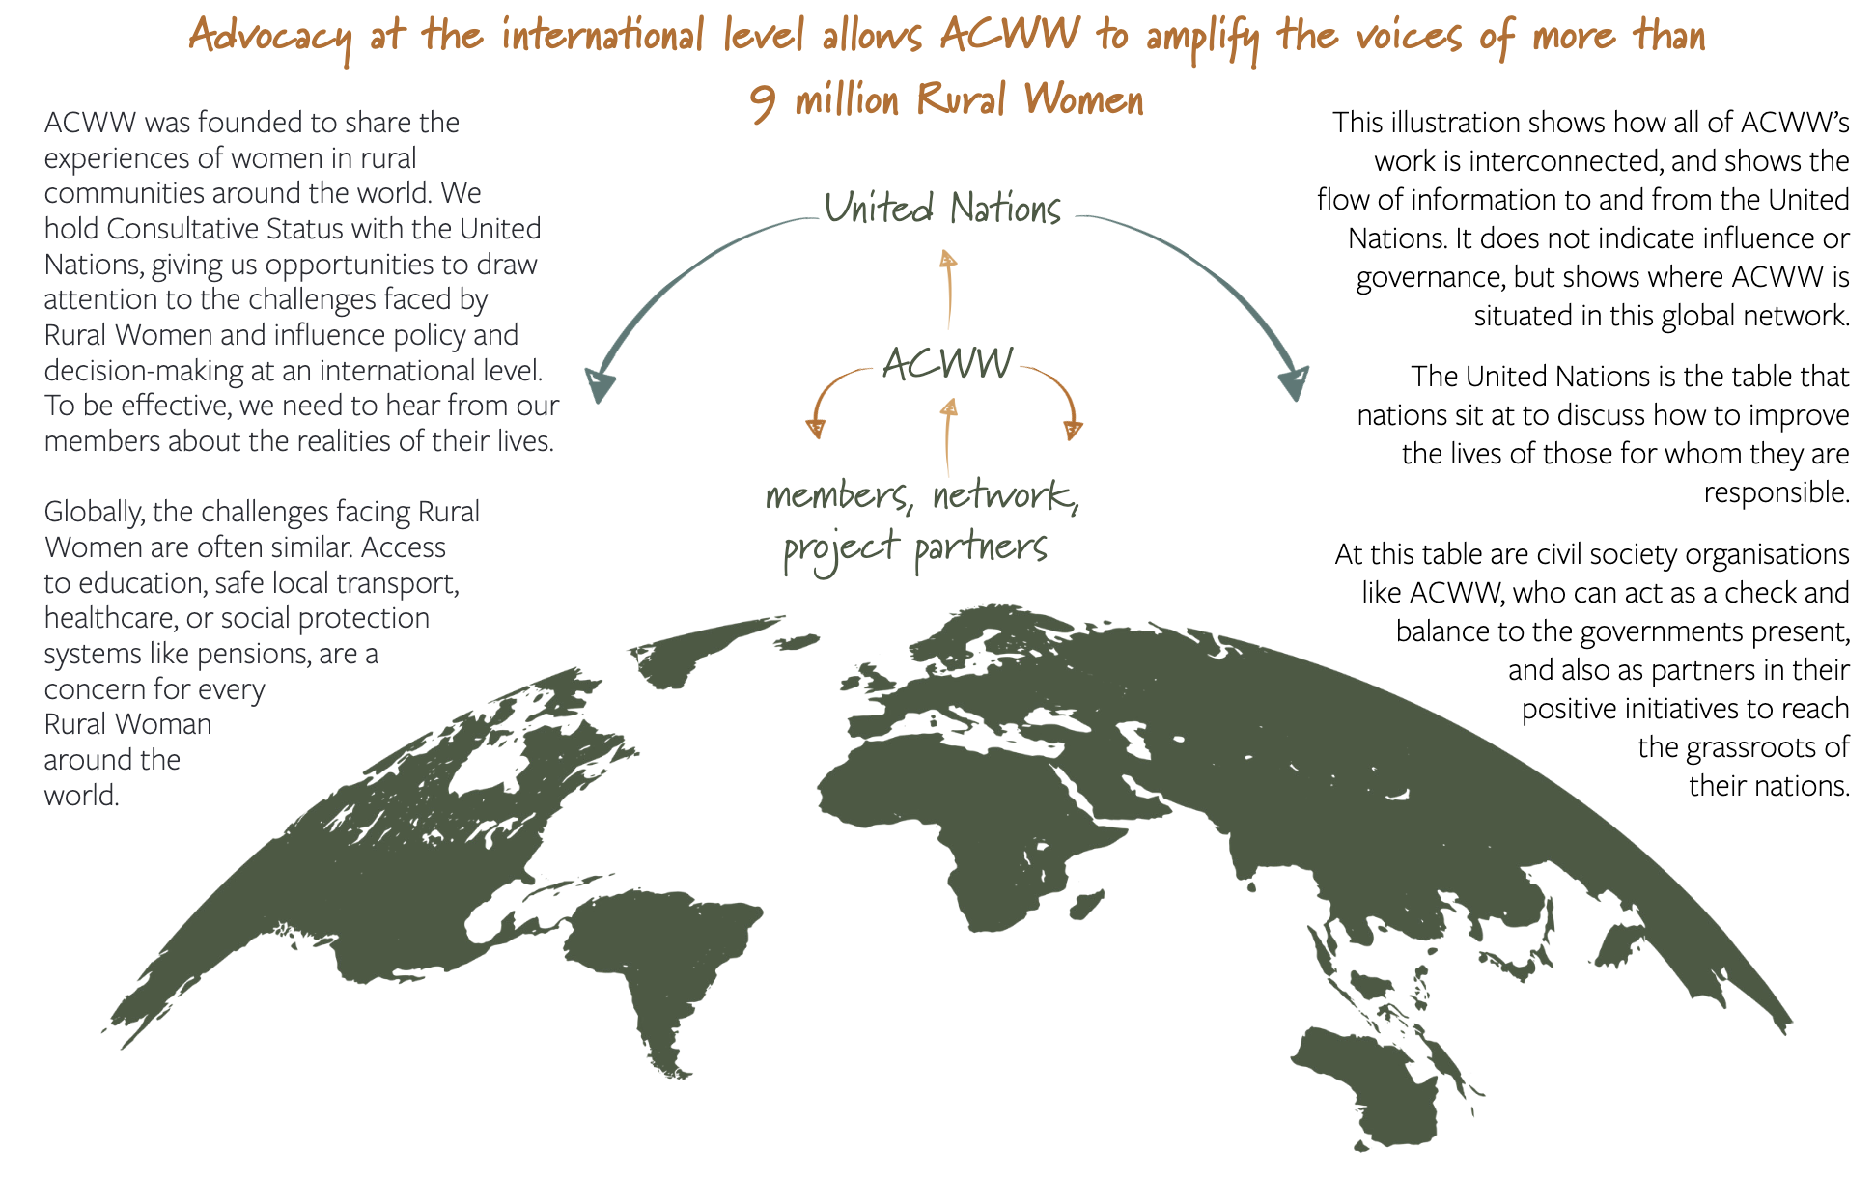
Notes:
ACWW work with The United Nations Economic and Social Council. With ECOSOC, we have access to critically important mechanisms such as the Commission on the Status of Women, the High-Level Political Forum on Sustainable Development, the Human Rights Council, and other processes
The Food and Agriculture Organization of the United Nations. With the FAO, we advocate for the importance of family farming, women’s land rights, Indigenous seed protection, food security and food sovereignty.
ACWW is also a member of the NGO Major Group, one of the Major Groups and Other Stakeholders at the UN established as part of the 2030 Agenda. We work with likeminded organisations from around the world to advance our goals and ensure our 14 members are heard.
ACWW is an elected member of the NGO-UNESCO Liaison Committee for the 2020- 2022 mandate. We represent the more than 400 NGOs who hold Official Partnership status with UNESCO, and in 2021 ACWW chaired the 12th International Forum of NGOs in Official Partnership.
UN Education and Scientific Council. At UNESCO we advocate for equitable access to quality education at all levels for women in all their diversity, the importance of traditional and inherited knowledge, Indigenous languages, and global citizenship

Slide 14
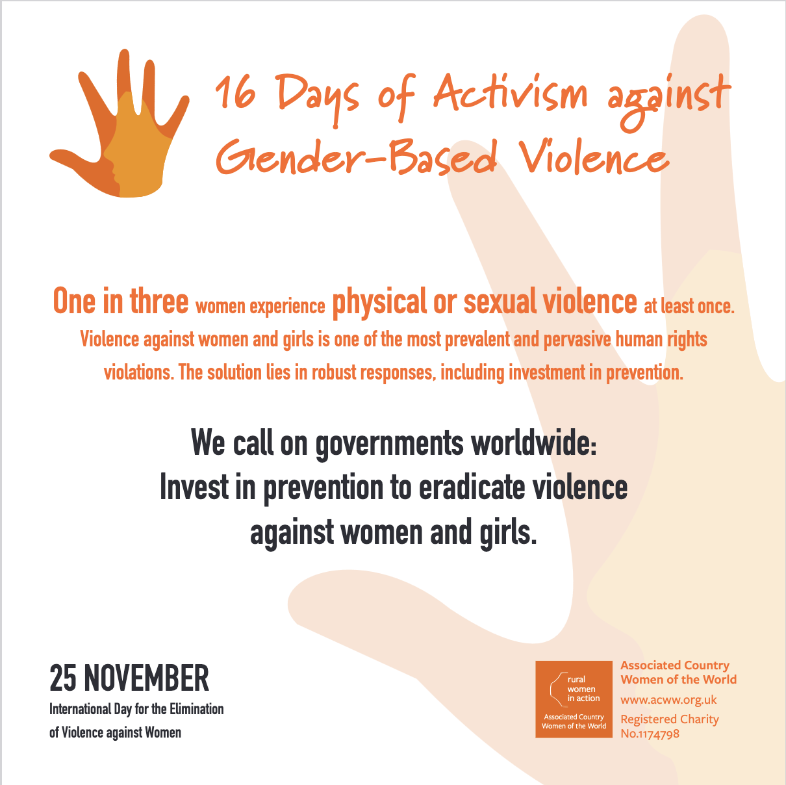
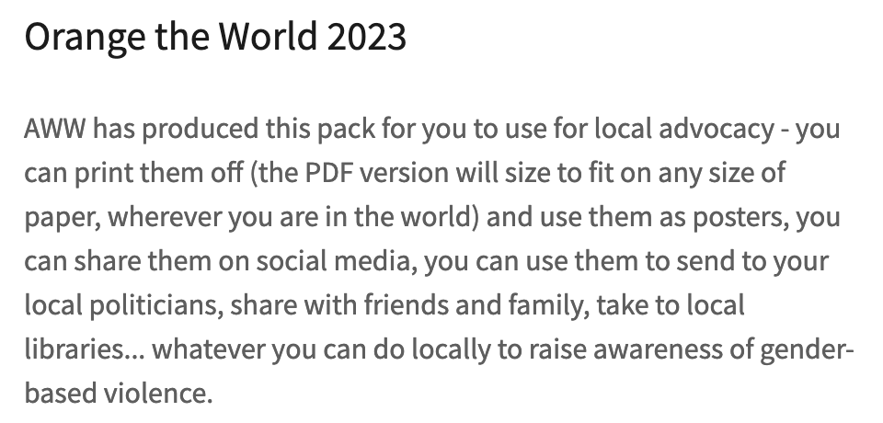
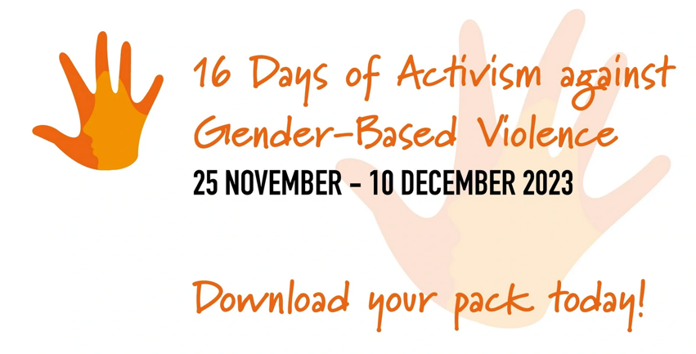

Slide 15
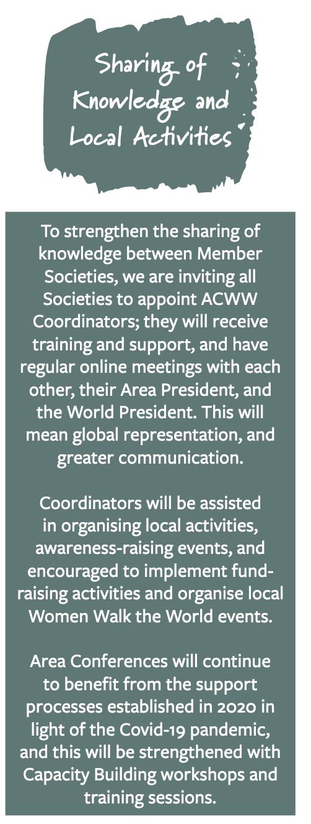
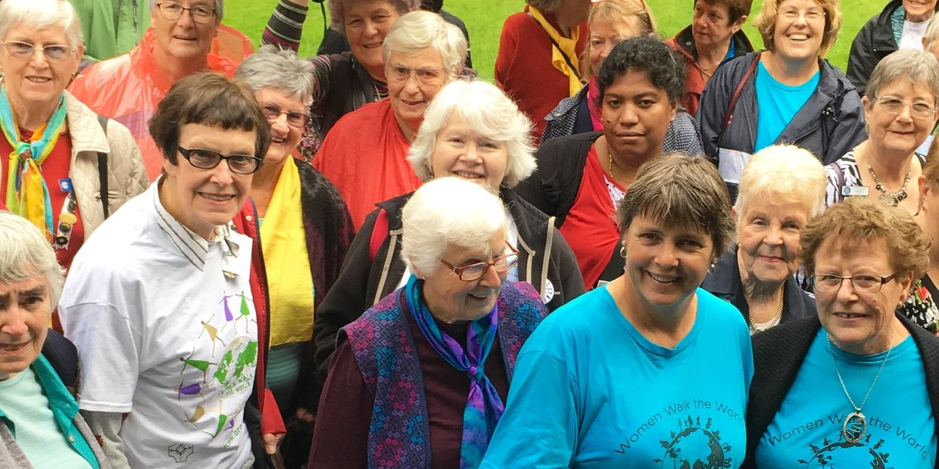
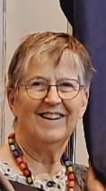
ACWW Coordinators
for Member Societies
RWNZ Southland Interprovincial: Ann Irving
TBD: RWNZ Head Office
RWNZ South Canterbury
RWNZ Taranaki Area Branch
RWNZ Rimanui Branch

Slide 16
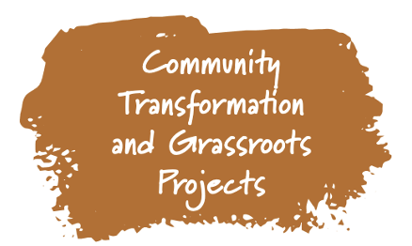
See you soon ...
31st Triennial World Conference
27 April to 1 May 2026
Ottawa, Canada
South Pacific Area Conference
8 to 12 September 2024
Griffith, NSW, Australia

Slide 17
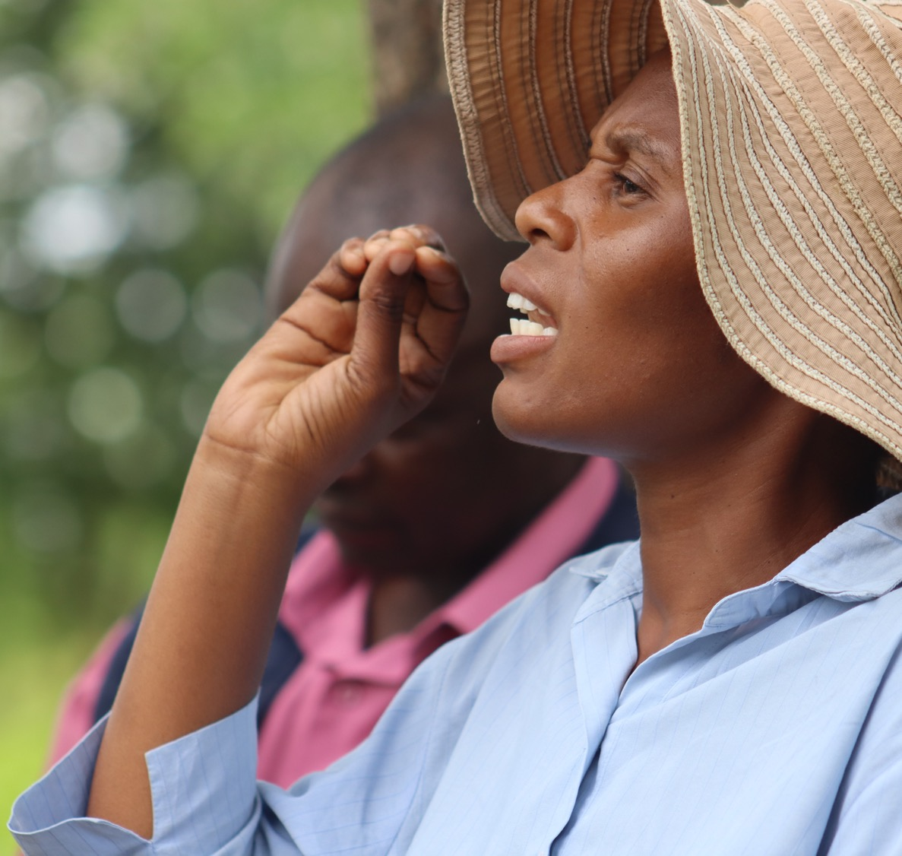
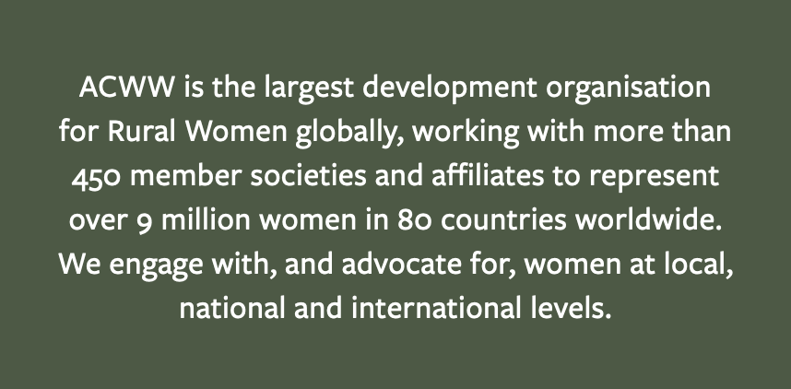
Support our work
JOIN as a society or individual
DONATE to the RWIA Fund
PARTICIPATE in our events and online
ENGAGE in your local community

Slide 18
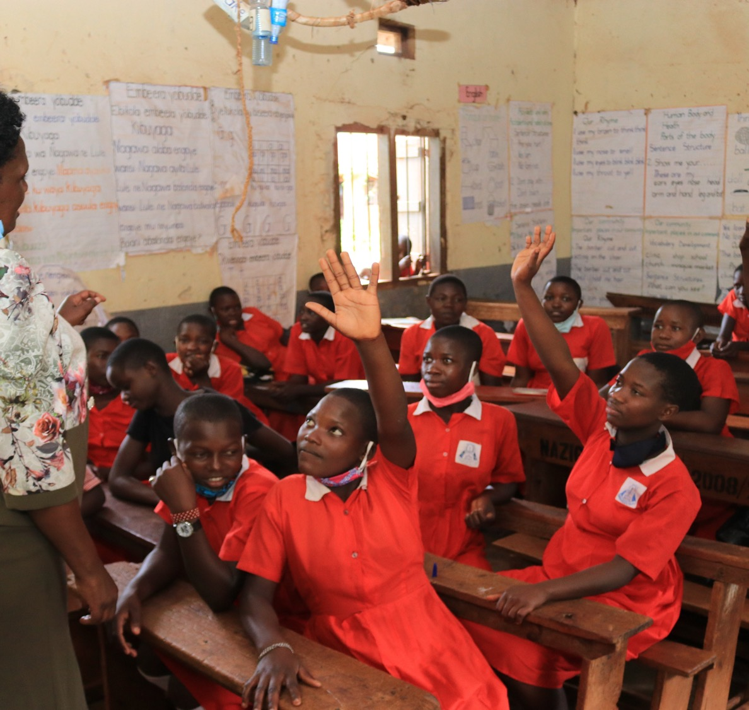
Support our work
www.acww.org.uk
office@acww.org.uk
Facebook.com/acww.media

Slide 19
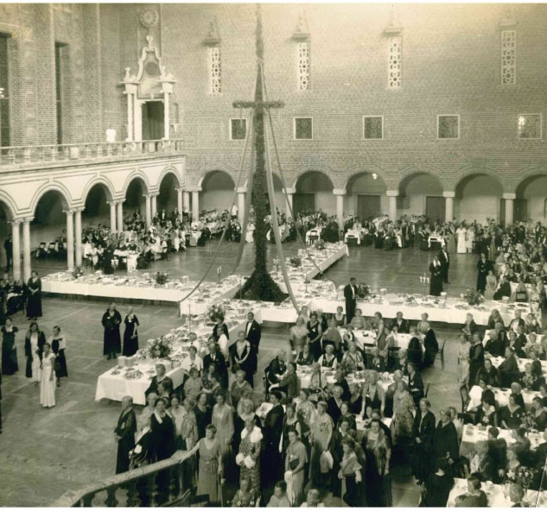
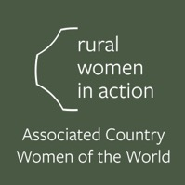
History
Founded in 1929, out of a committee of the International Council of Women. This committee was called the Liaison Committee of Rural Women’s Organisations.
“To stimulate interest in the international aspects of rural life and development,” “to work together for the betterment of rural homes and communities…” and “to further international relations in every way consistent with the Aims of the Association.”
Notes:
The Associated Country Women of the World was founded in 1929 to bring rural women and their organisations all over the world together, and in so doing address the challenges they faced because of the isolation of their communities, discrimination against women, and their lack of standing in political processes.
ACWW’s membership spans 82 countries, and since 1947 we have passed more than 180 policy resolutions by popular vote. The key concept behind each of these is the empowerment of rural women in all their diversity, and this continues to be our driving priority.
This photo is from the Gala at the second Triennial World Conference held in Stockholm, Sweden in 1933.

